Slide 1
TV-show logger
TV Show Logger is a social tracking app that allows users to log, rate, and discover new shows, while also exploring what other users are watching.

Slide 2
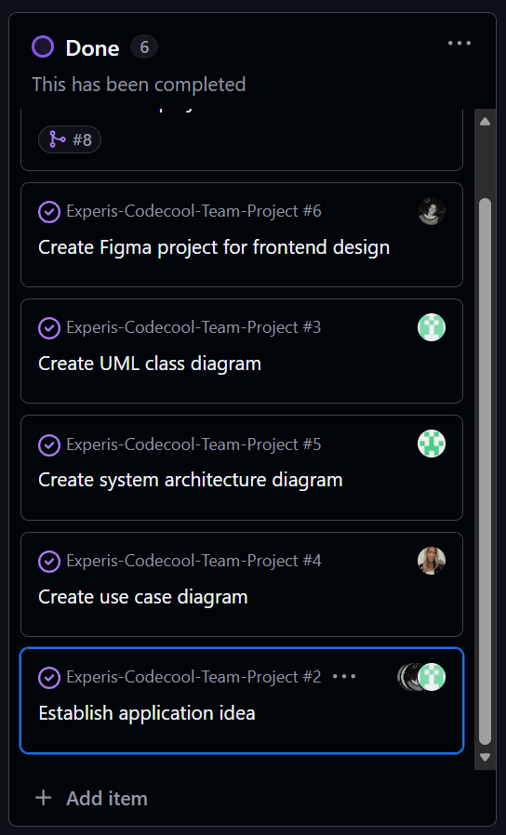
Contents
Sprint 1
  Brainstorming
  Diagrams
    UML
    Use case
    System architecture
  OpenAPI spec
  Project structure

Slide 3
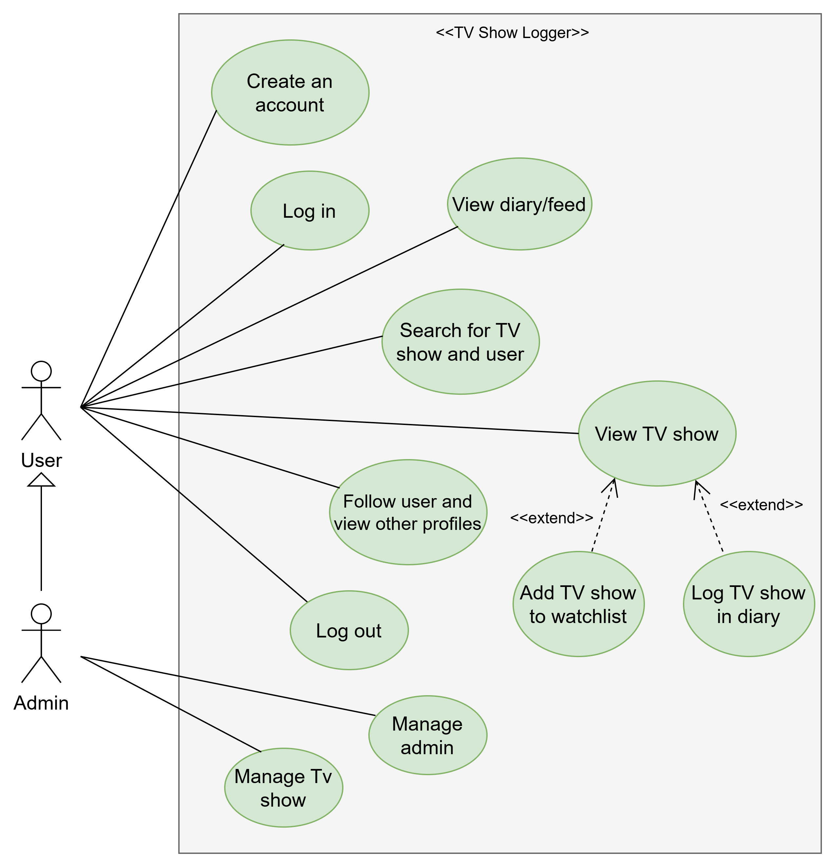
Use case diagram

Slide 4
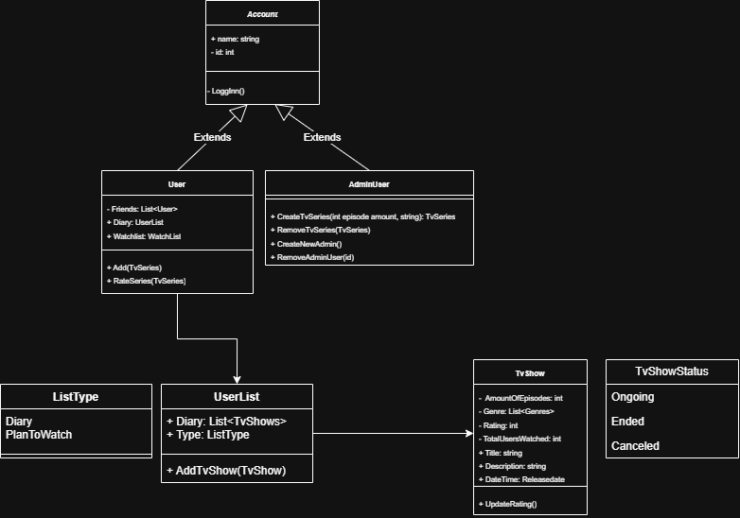
UML Class Diagram

Slide 5
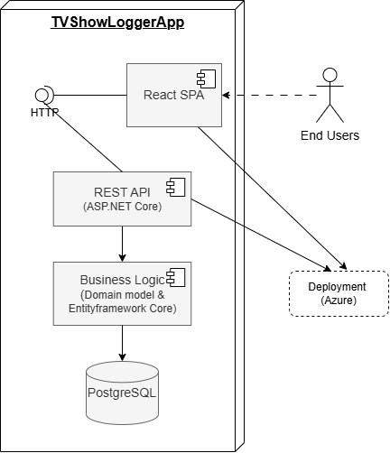
System architecture diagram

Slide 6
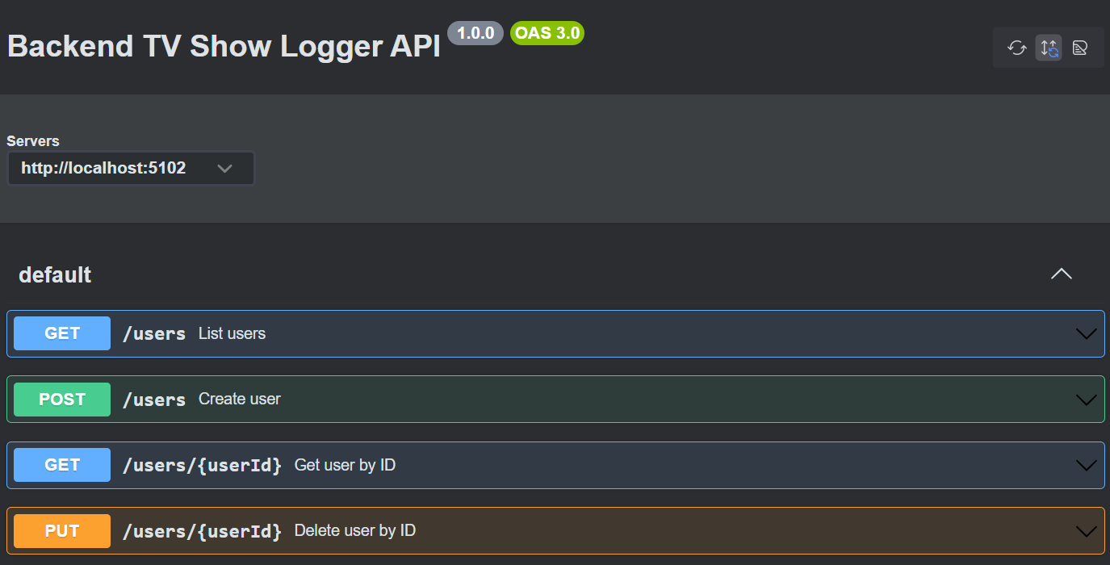
OpenAPI specification

Slide 7
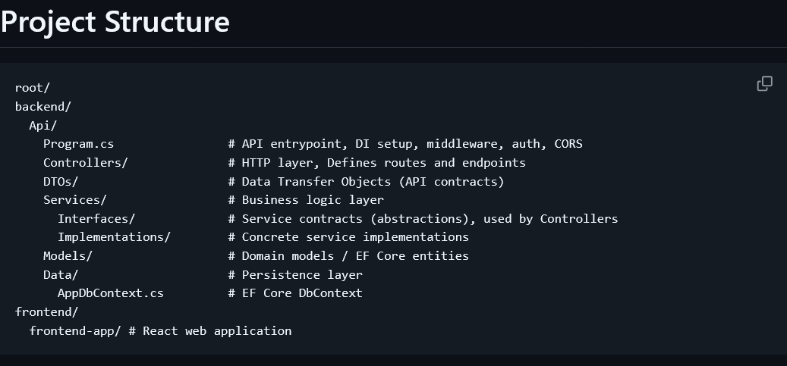
Project Structure

